Slide 1
Sketching with Data Opens the Mind’s Eye
Akshat Baranwal

Slide 2
What is DATA?
Data is collection of facts, such as numbers, words, measurements, observations or just description of things.
Qualitative data (Descriptive information)
Quantitative data (Numerical information)
EXAMPLE?

Slide 3
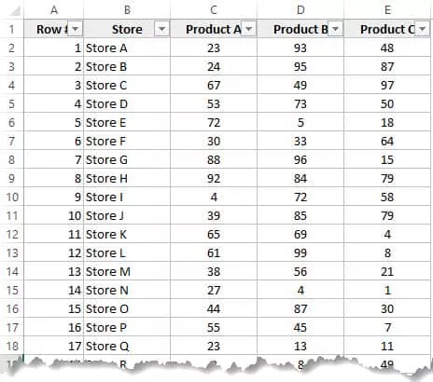
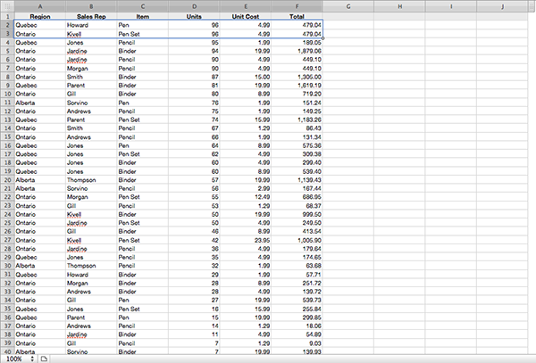
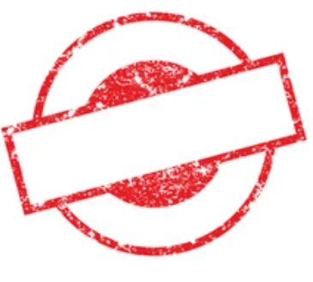
What do you see when looking at this data?
BORING

Slide 4
Numbers and Field Names
It's not easy understanding the data when you’re looking at the number of entries and field names. You might have a basic understanding but it's hard to really dig into the patterns of the data. The key to understanding lies in data visualization…

Slide 5
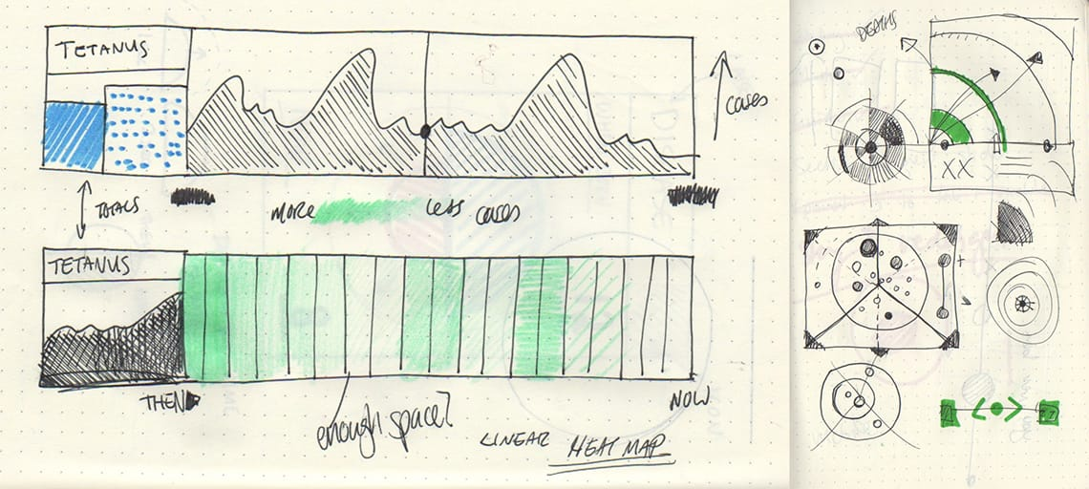
Data-Visualization
Despite most people associating this word with heavy programming skills, complex softwares and huge numbers, a primary tool that data visualization designers use is sketching and drawing by hand.
“They sketch with data to understand what is in the numbers and how to organize those quantities in a visual way to gain meaning out of it”.

Slide 6
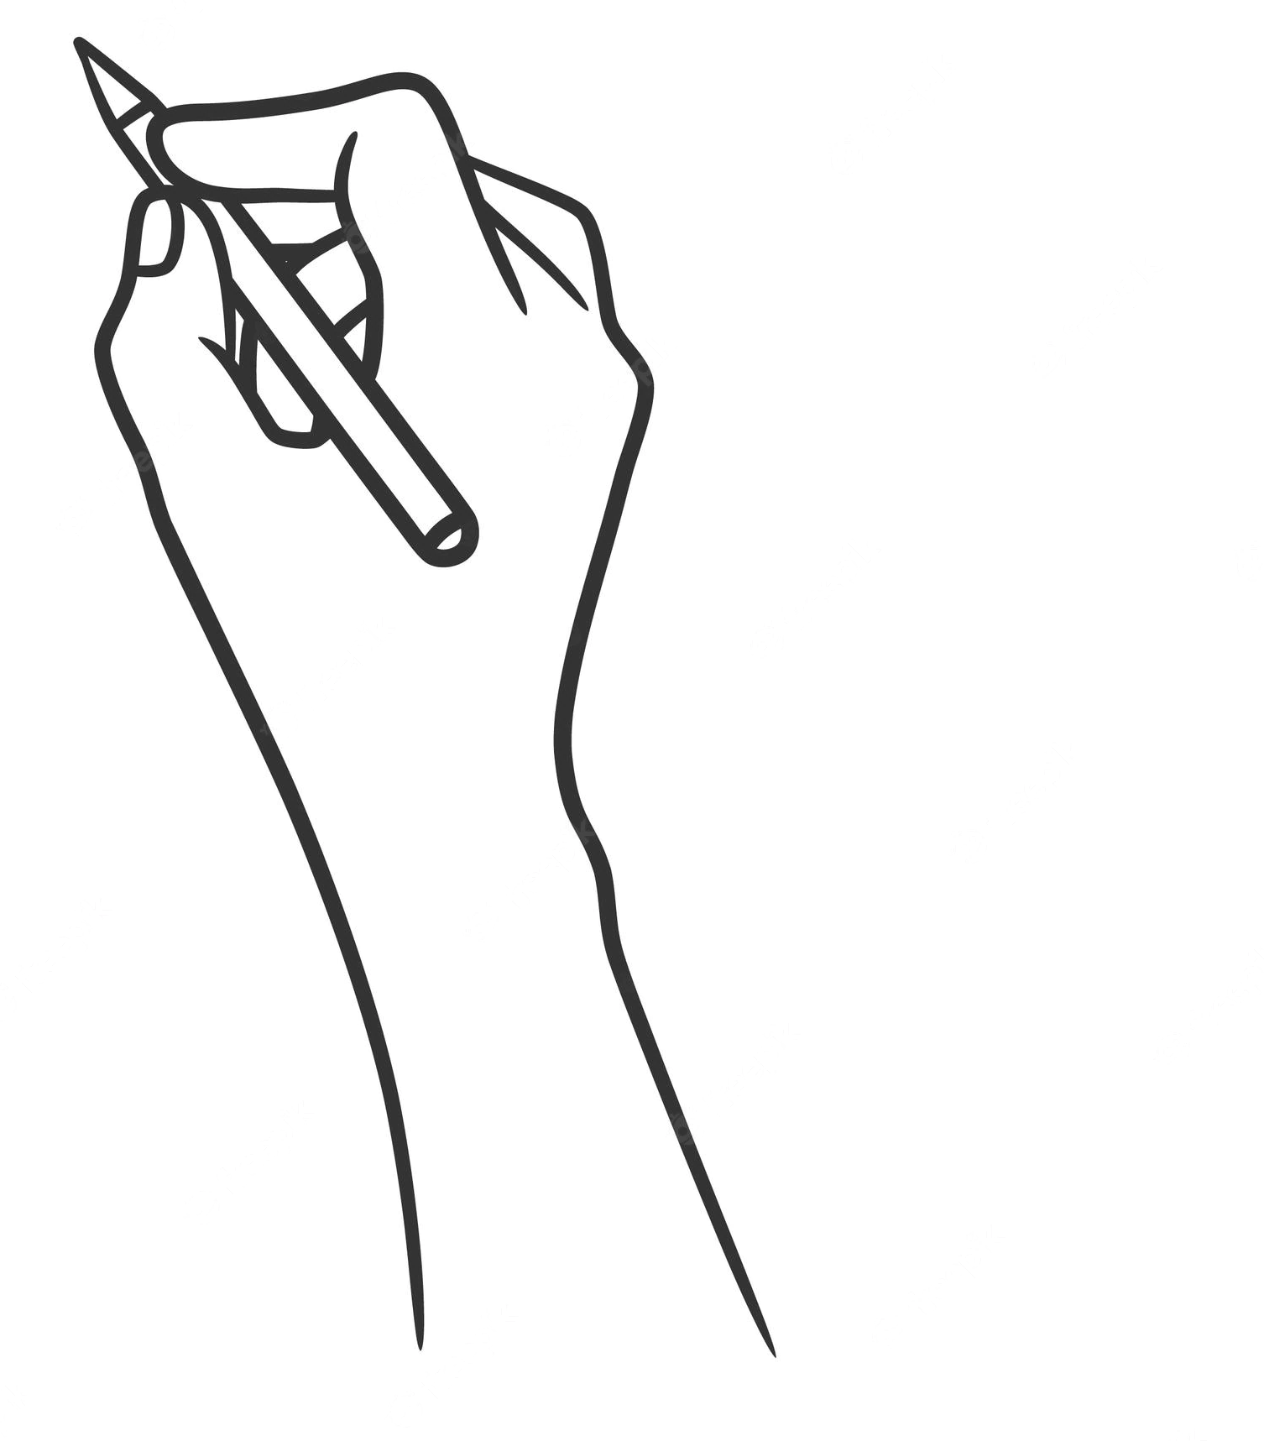
We live in a world where data visualisations are done through intricate code and graphic design. From Tableau to Datawrapper and Python and R, numerous possibilities exist for visualising compelling stories.
But do you know?
In the beginning, all data visualisation was done by hand.

Slide 7
Zillion years earlier…
.
Maybe few hundred years ago :)

Slide 8
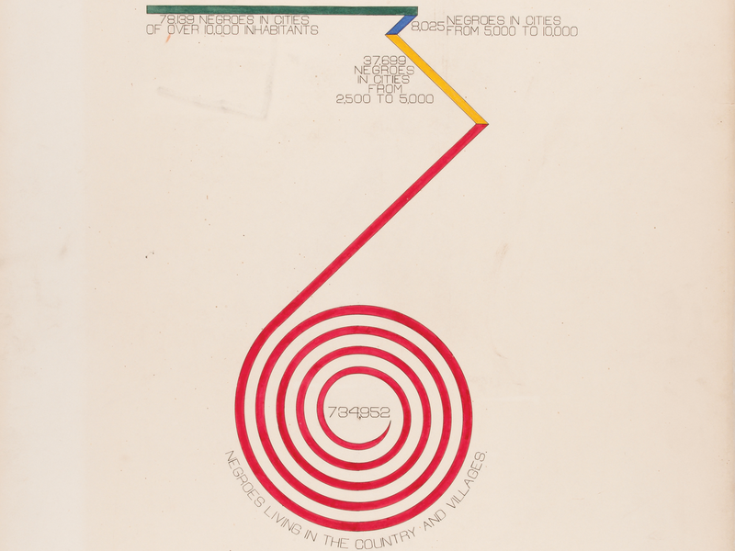
Close up on Atlanta University's "City and Rural Population. 1890" data visualisation by W. E. B. Du Bois

Slide 9
Drawing in visualization
Drawing is a medium for observing, representing, thinking, visualizing, and conveying design ideas. It is based on the belief that drawing is essential to the design process. Drawing by hand is emphasized since it is the most natural and direct way we have of expressing our visual thoughts and perceptions. Drawing's tactile nature helps us learn spatial concepts and the crucial capacity to think and envision in three dimensions in direct response to our visual thoughts and sensations.

Slide 10
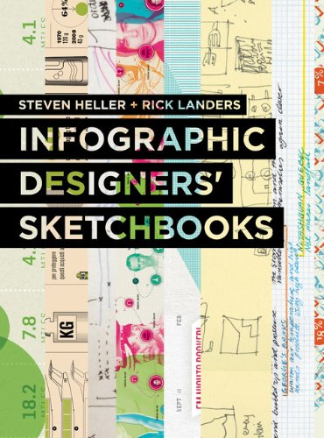
Infographic Designers’ Sketchbooks
Authors Steven Heller and Rick Landers wrote a book Infographic Designers’ Sketchbooks where they breakdown early stage infographics from projects from data visualizers all over the world.
Heller makes the distinction that “...the art of information display is every bit as artful as any other type of design or illustration, with the notable exception that it must tell a factual or linear story”.

Slide 11
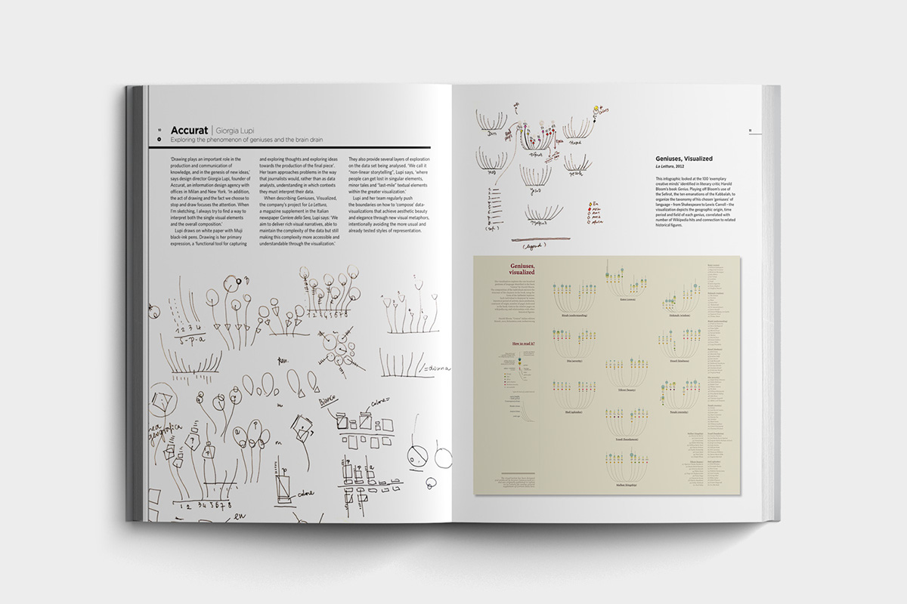

Slide 12
When exactly does drawing become design?
“Drawing becomes design when you start tracing lines, symbols and structures that help rationalize thoughts and envision a possible solution to a design problem, drawing becomes design when it’s used as a tool in the process of visual planning and organizing the choices made during the development of a project”.

Slide 13
Is digital drawing better?
So, handmade data visualisation is not something new. In fact, it is the original form of visualisation! But, as computer tools have evolved to make it easier to create data visualisations, more and more visuals are ‘born digital’. Although,
A handmade visualisation can lend a feeling of friendliness to a story.
Hand drawing gets you thinking outside the box.
Handmade visualisations feel more ‘truthy.’

Slide 14
3 Phases of Data Visualization
Phase 1: General Structure
Phase 2: Singular Data Points
Phase 3: Prototype

Slide 15
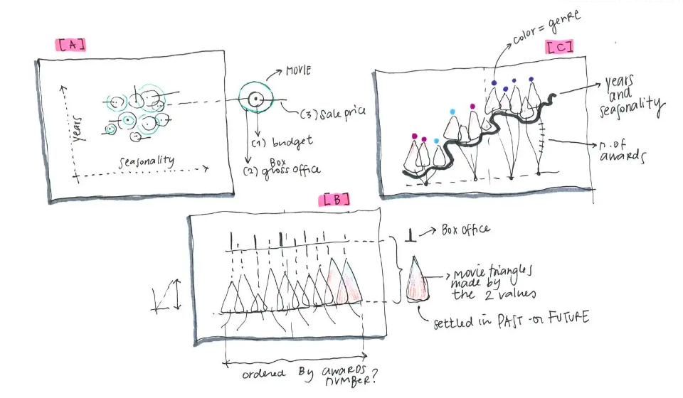
Phase 1: General Structure
Phase 1 is about organizing the data into the categories and fields you will be using during the drawing process. Not so much using actual data. This allows you to think about the potential structure of the sketch.

Slide 16
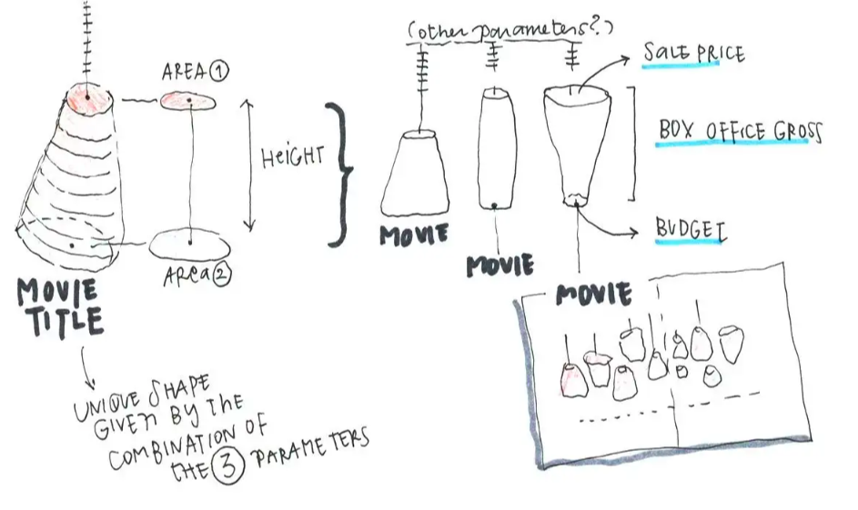
Phase 2: Singular Data Points
Phase 2 is about deciding the shape, color, and structure of each data point. This gives a character to each type of data, and allows you to find the best way to express them.

Slide 17
Just from these two phases, the designer is forced to think about the data in a way looking at the numbers does not ask them to.

Slide 18
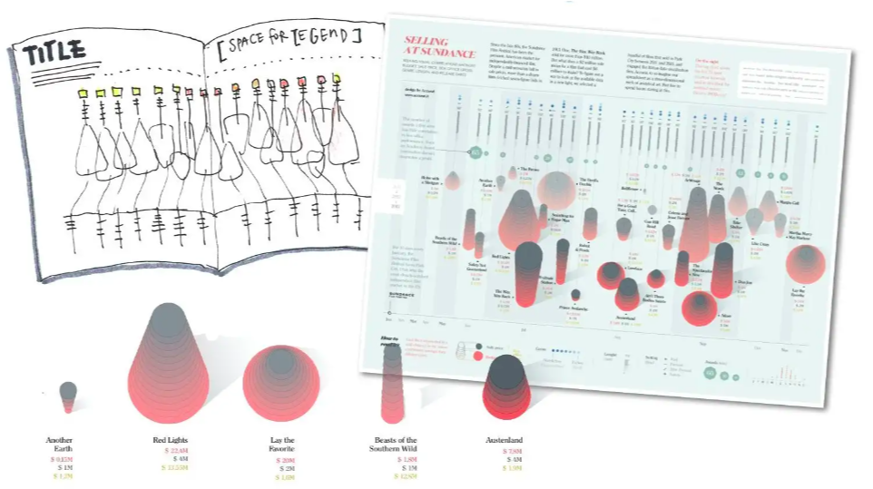
Phase 3: Prototype
Phase 3 combines the structure and shape figured out in the previous steps into a prototype. The prototype could also be done digitally because the birds eye view nature of this process shines during the first 2 steps. Having done those steps, it's easy to craft the story benign told in the prototype.

Slide 19
Final Quote
“...when I am sketching to explore the dimensions of a dataset, I don’t have access to the actual data with my pen and paper, but only to it’s logical organizations, and this is an invaluable asset to focus on the meaning of information, and not on numbers out of context”.

Slide 20
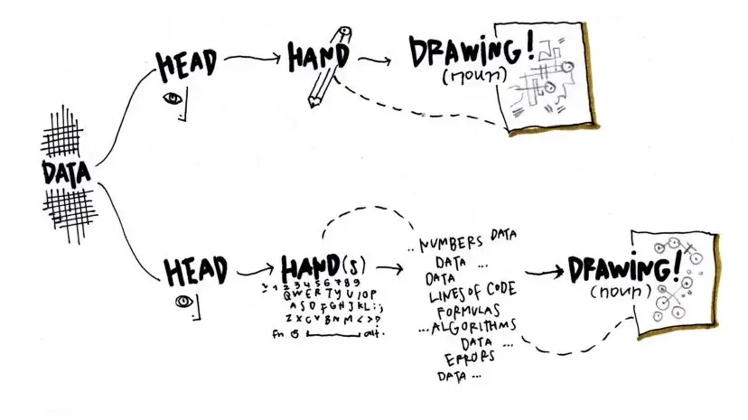

Slide 21

Any suggestions are heartily welcome.
Still have doubts? Ask!

